Slide 1
Page Layout
WEBD 120 - Web Programming 1
Link to slides: http://bit.ly/humber-web-5
Ryan Christiani
Week 5

Slide 2
Assignment retake.
If you got less than 60%. I am offering the ability to redo the assignment. You can hand it in by next week. And you will get a maximum of 60%.

Slide 3
Review
Floating
Clearing
Positioning

Slide 4
Floating
CSS floats are used to align elements left or right. This property also clears up the need to use deprecated elements and attributes.
.box1 {
width: 200px;
height: 100px;
float: left;
}
.box2 {
width: 200px;
height: 100px;
float: right:
}

Slide 5
Clearing
By default html block level elements are follow something called the stacking order. Meaning elements will just stack one on top of each other.
Floating an element takes that element out of the stacking order.
Lets look at with happens when we float some items.
http://jsbin.com/kofise/4/

Slide 6
Clearing cont.
clear takes 3 commonly used values, left, right and both.
The clear CSS property specifies whether an element can be next to floating elements that precede it or must be moved down (cleared) below them.
If you have 2 elements and you float the first one right and add clear: right; to the one under it. It will stay under the element. If we did not have a clear of right on the element it would sit beside out floated element.
http://jsbin.com/cirara/3/

Slide 7
Overflow
You can also use the overflow property to clear a float. The overflow property lets you control the overflow. If you have a parent element that is shorter than the content inside you can use overflow: scroll and that will add a scrollbar to the parent element.
To clear a float we can use the overflow: hidden option. This worked because it triggers something called hasLayout on the element.

Slide 8
Position
Another way to affect the layout of an element is to use the position property. position takes a few different values, but commonly you will see relative, absolute, or fixed. When you position on something it is considered ‘positioned’.
relative: This keyword lays out all elements as though the element were not positioned, and then adjust the element's position, without changing layout (and thus leaving a gap for the element where it would have been had it not been positioned).

Slide 9
Position
absolute: Do not leave space for the element. Instead, position it at a specified position relative to its closest positioned ancestor or to the containing block.
fixed: Do not leave space for the element. Instead, position it at a specified position relative to the screen's viewport and don't move it when scrolled.

Slide 10
Position Examples
Lets do an example in our editors.
Create a new file and create the base html structure.
We will play around with position relative, absolute and fixed.

Slide 11
Images
We briefly went over images, so here is a review. Images are pretty straight forward. They have 2 main attributes, src and alt.
<img src=”imgs/logo.jpg” alt=”Company Logo” />
src = the path to the image.
alt = a brief caption about the image, important for accessibility.

Slide 12
Background images
You can also add an image with css as a background for an element. You do this using the background-image property.
background-image: url(...path to image…);
It takes one property, a url path to the image, this can be an absolute or relative path. You can also size the image with the background-size property. You would use this if the image is too large.
background-size: 100%;

Slide 13
Background images cont.
You can also let the image repeat with the background-repeat property.
background-repeat: repeat-x;
Take a look at this documentation to see all the properties and values you can add.
https://developer.mozilla.org/en/docs/Web/CSS/background

Slide 14
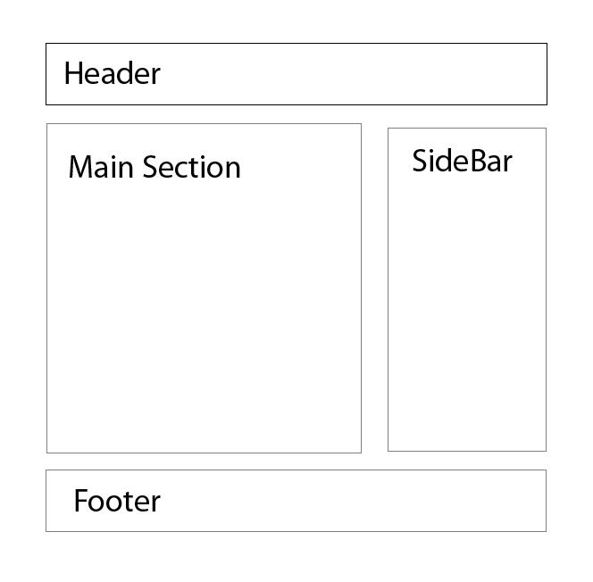
Laying out a page with CSS
Let’s take what we have learned to date and create a website. We will use the same markup that we had set up for the last assignment.
Lets walk through setting up a page like this, using semantic markup, as well as css class and id names .

Slide 15
Assignment
With the mark up from the last assignment. You are asked to style this page with CSS.
You will have to use floats, margins and padding.
Here is a link to the assignment breakdown. This will be due in 2 weeks, beginning of class on the 14th

